Slide 1

My Personal Webpage
Welcome to my personal webpage! I'm excited to share my skills, experience, and education with you.

Slide 2

My Skills
1
Web Development
2
Project Management
Experienced in HTML, CSS, Javascript, and React.
Ability to manage tasks effectively and meet deadlines.
3
Communication
Strong communication skills and ability to collaborate with team members.

Slide 3

My Experience
Software Engineer Intern
1
Developed and maintained web applications for a leading tech company.
2
Front end developer
developed many project as a front end developer

Slide 4
My Education
Bachelor of Science in Computer Science
K.V.Dogra Lines
KIET MURADNAGAR
This is where I embarked on my educational journey, laying the foundation for all to come.

Slide 5
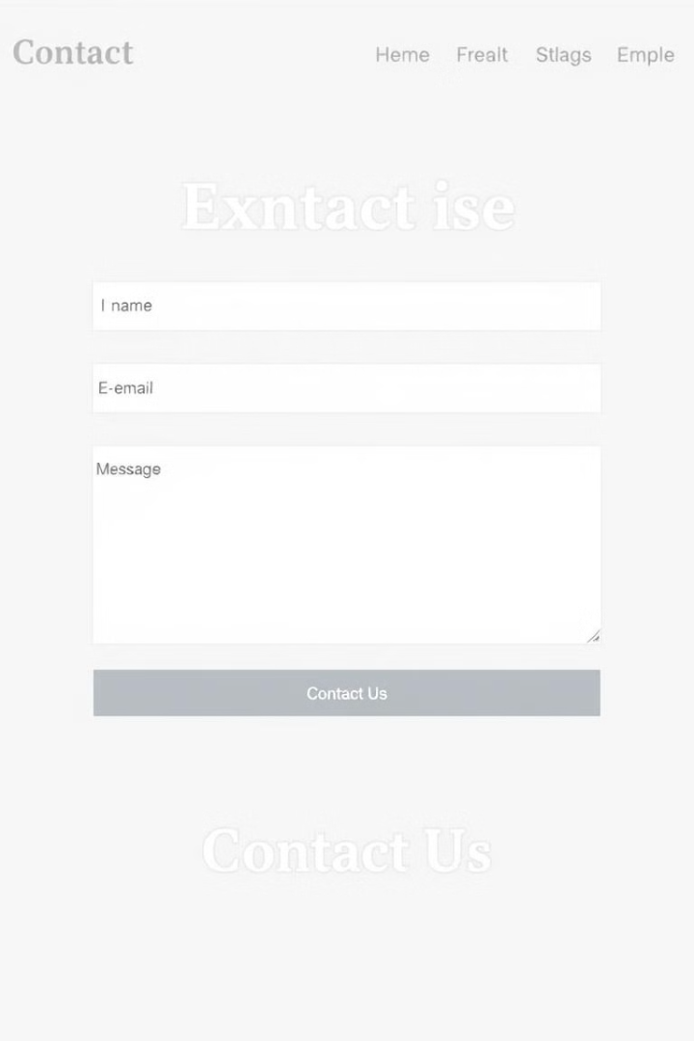
Call-to-Action
Let's connect! Feel free to reach out via email or social media.

